Slide 1
Introduction to Computing for Data Analysis
Pairwise association mining
Richard Vuduc, Ph.D.
Associate Professor
School of Computational Science and Engineering
Designing an algorithm 1 Tabulating co-occurrences

Slide 2


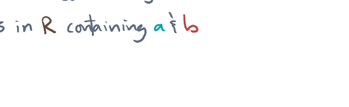

Computes conf(a ⇒ b) to estimates Pr[b|a]

Slide 3




Slide 4


Slide 5



Slide 6



Slide 7


Slide 8


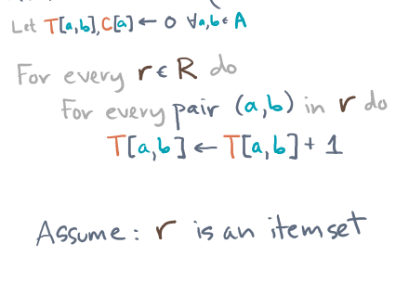



Slide 10
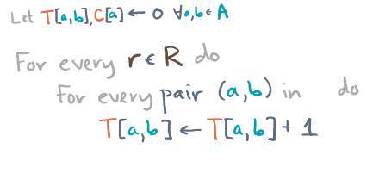


Slide 11
